Slide 1
Accessing RAC from Windows
Preparation

Slide 2
Problems with the Key
RAC (along with AWS and Openstack) allow the user to create a keypair for accessing instances.
The problem is that the format of the private key is a .pem format.
Putty (a free SSH client for Windows and Linux) does not recognize the .pem format.
It uses the .ppk format

Slide 3
How to Convert PEM to PPK
We can easily remedy this problem by downloading another free Putty program called Puttygen.
We can use Puttygen to convert the pem file to a ppk file that we can use with Putty.

Slide 4
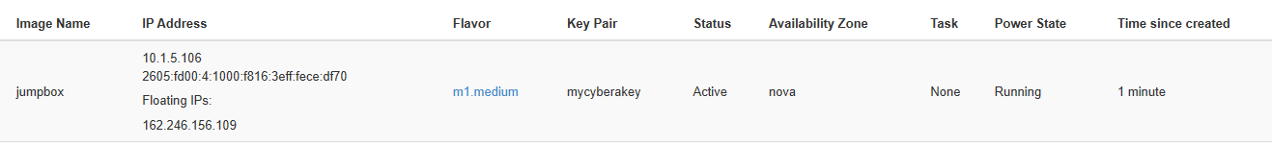
In Cybera’s RAC
We start an Ubuntu instance as we normally would.
We inject our key and assign the instance a floating IP address.

Slide 5
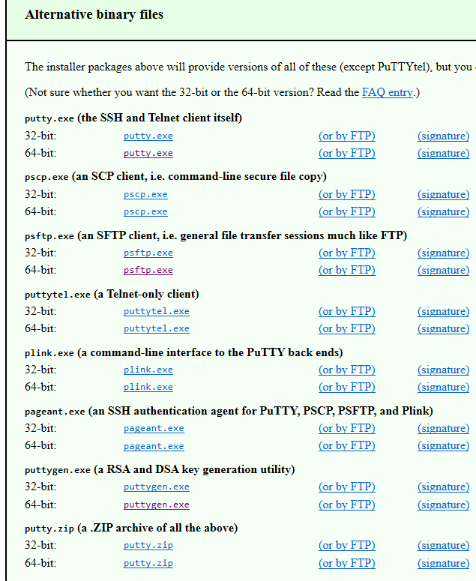
Downloading the Putty Software
We will need putty and puttygen.

Slide 6
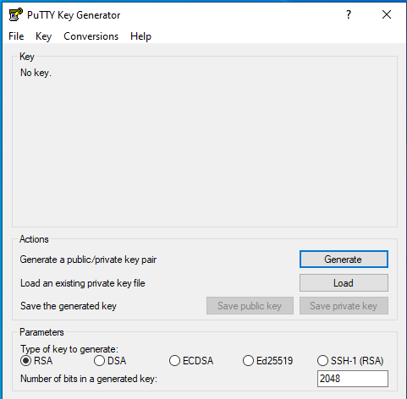
Using Puttygen
The screen on the right shows puttygen when first started.

Slide 7
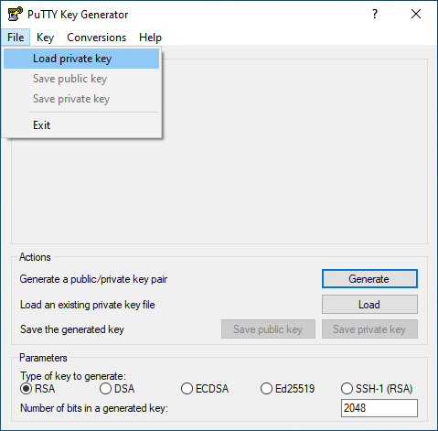
Importing the PEM key

Slide 8
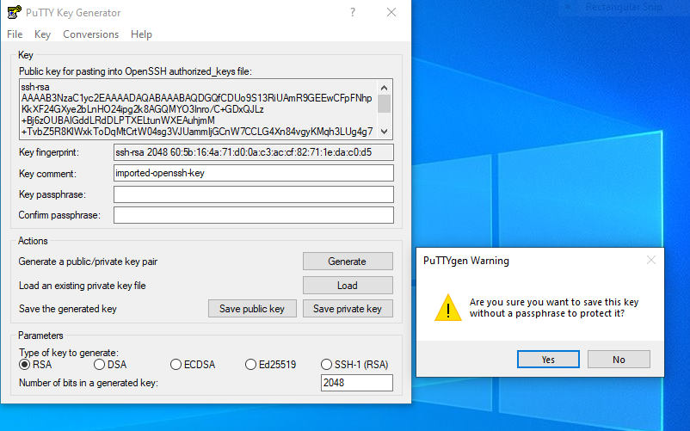
Saving the Key to a PPK format
Make sure that you use the “Save private key” option and confirm “no passphrase” option

Slide 9
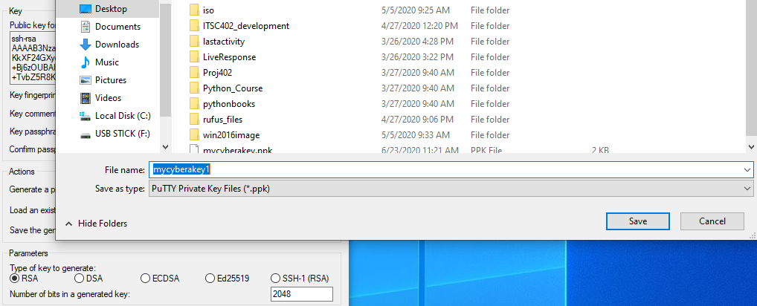
Saving the Key to a PPK format

Slide 10
Using Putty
Now that we have converted the key file to ppk, we can use it in Putty to access our running instance.
There are three steps that need to be done in Putty to use the key to access the instance.

Slide 11
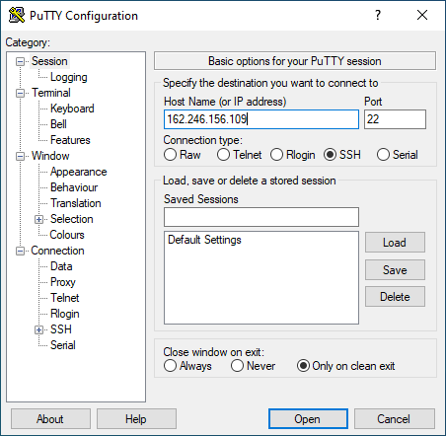
Using Putty
Type in the floating IP or our instance.

Slide 12
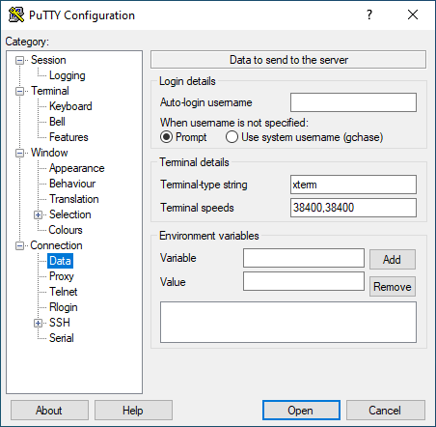
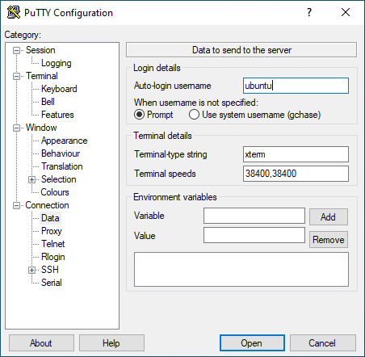
Using Putty
Add the instance’s user name (“ubuntu” for the ubuntu instances or centos for Redhat-based distributions).

Slide 13
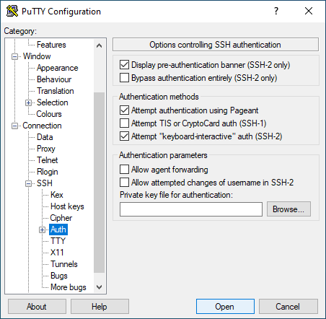
Using Putty
Select the key to use.

Slide 14
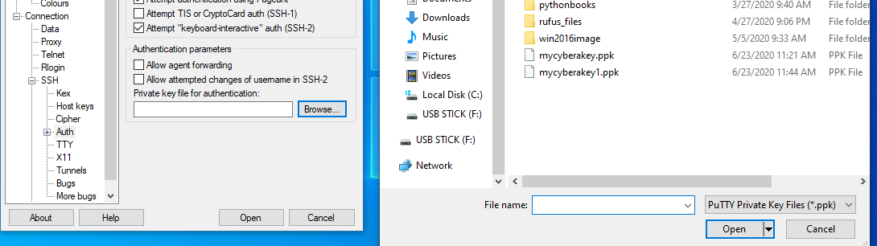
Using Putty
Select the key to use. Select the ppk key that you just created.

Slide 15
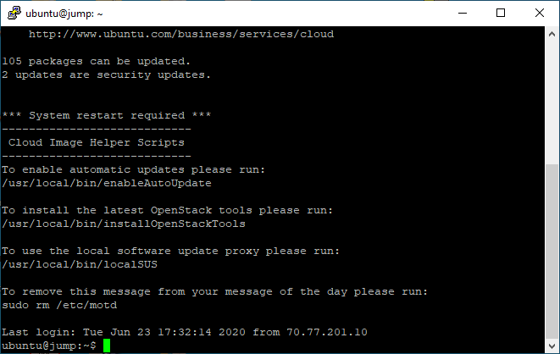
Using Putty
Now you can “connect” to your instance

